Slide 1
Digital Engineering Strategy and Implementation
2022 Defense Standardization Program (DSP) Conference
Darryl Howell
Contractor Support
Digital Engineering Modeling & Simulation
Office of the Under Secretary of Defense (Research & Engineering)
1-4 August, 2022

Slide 2
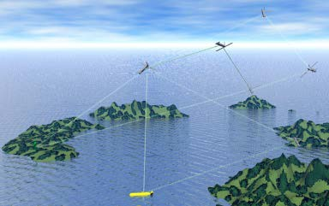
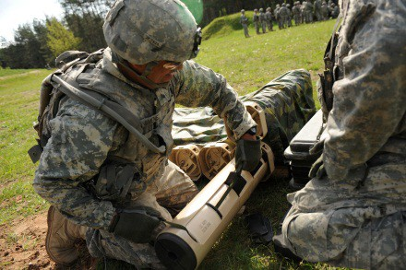
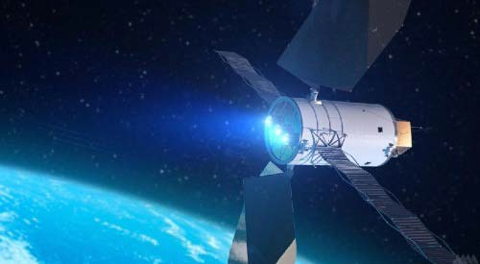
Under Secretary of Defense (Research & Engineering)
Technology Vision for an Era of Competition
Champion research, science, technology, engineering, and innovation to maintain the United States military's technological advantage
  Primary advisor to DoD leadership on all matters pertaining to the Department’s Research and Engineering (R&E) enterprise, tech development and transition, developmental prototyping, experimentation, and administration of test ranges and activities
  Lead responsibility within DoD for synchronizing Science and Technology (S&T) efforts across the DoD, the Joint Staff and the Services
Harness the incredible innovation ecosystem both domestically and globally in order to stay ahead of our competitors

Slide 3
Critical Technologies
“...the Department will urgently build enduring advantages across the Defense ecosystem...”
– National Defense Strategy (2022)
Biotechnology
Quantum Science
Future Generation Wireless
Advanced Materials
Trusted AI and Autonomy
Integrated Network SoS
Microelectronics
Space Technology
Renewable Energy
Advanced Computing and Software
Human Machine Interface
Directed Energy
Hypersonics
Integrated Sensing and Cyber
OUSD(R&E) will develop critical technologies, rapidly prototype them, and conduct continuous campaigns of
joint experimentation to improve on those technologies and deliver capabilities.

Slide 4

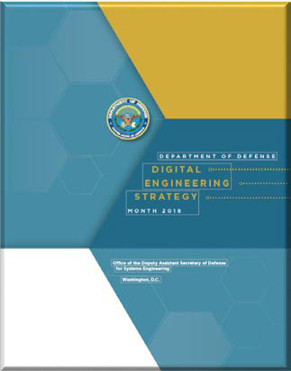
National Defense Strategy and Digital Engineering Strategy
Transform the Foundation of the Future Force: Building the future Joint Force that we need requires overhauling the Department's force development, design, and life-cycle management systems.
Objective: Guide the planning, development, and implementation of digital engineering across the services and agencies
Expected Impact:
  Increased technical cohesion and awareness of system in lifecycle activities
  Reform the Department’s business practices for greater performance and agility
Our Response: Prioritize speed of delivery, continuous adaptation, and frequent modular upgrades.
https://www.defense.gov/Spotlights/National-Defense-Strategy/
https://ac.cto.mil/digital_engineering/
Notes:
National Defense Strategy (NDS) priorities: 1. Defending the homeland, paced to the growing multi-domain threat posed by the PRC. 2. Deterring strategic attacks against the United States, Allies, and partners. 3. Deterring aggression, while being prepared to prevail in conflict when necessary, prioritizing the PRC challenge in the Indo-Pacific, then the Russia challenge in Europe. 4. Building a resilient Joint Force and defense ecosystem. (Source: NDS Fact Sheet)
Digital Engineering Strategy (DES): As the Department of Defense continues to relentless implement the NDS, the DES sets a vision for the way the department conceives, builds, tests, fields, and sustains our national defense systems. So essentially, the strategy defines the "what," and the Services are developing implementation plans defining the "how."

Slide 5


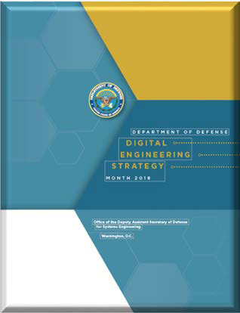

































Digital Engineering Way Ahead
Collaborators/Partnerships Strategy & Service Plans Next Steps
Outlines DoD’s five strategic goals for Digital Engineering initiatives
Digital Engineering Policy
  Regular updates of Services Digital Engineering Implementation at quarterly DEWG-COP meetings
Service, Industry, Academic, and Standards organization collaborations to further the Digital Engineering implementations
INCOSE/NDIA Digital Engineering Information Exchange Working Group to advance concepts
Research areas initiating in curation, credibility, and metrics
Service Implementation Plans
Implementing Digital Engineering Across the Department
Notes:
There are a host of collaborators and partnerships across the Services, components, inter-agencies, Industry, and academia. We have transitioned from the strategy to implementation, and we are working across our partners and collaboration to advance the concepts.
There is an OSD & Service led Digital Engineering Working Group Community of Practice that is addressing challenges for application and use of Digital Engineering across the department.
We have a partnership with INCOSE and NDIA to address methods for exchanging information across models and are working to establish standard model exchange methods
The Strategy outlines DoD’s five strategic goals for Digital Engineering initiatives. We are engaging in next steps to develop policy, stay informed with Services DE implementation progress, and continuing our partnerships with industry and academia to explore relevant research areas.

Slide 6
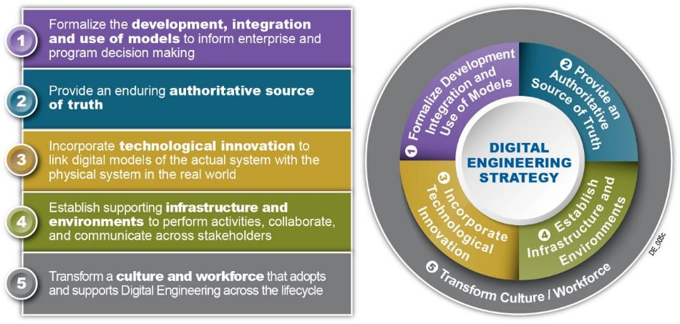
Digital Engineering Strategy: What, not How
Describes an integrated digital approach that uses authoritative sources of systems’ data and models as a continuum across disciplines to support life cycle activities from concept through disposal
Layman’s terms: combine standard representations of ‘system’, with computers, additional computational techniques as a continuous, complete and evolving ecosystem to provide data for data-informed decisions and interactive visualizations to a continuum of questions
6
Notes:
Digital Engineering is an model-based approach incorporates digital practices and computing infrastructure to enable delivery of high pay off solutions to the warfighter at the speed of relevance. It extends beyond traditional model-based approaches that typically focus on a particular discipline or aspect to encompass the broad spectrum of models as a continuum across the lifecycle.
And essentially connects people, processes, data, and capabilities which is essential to enable all stakeholders the ability to solve problems faster and in new ways.
The strategy was developed around 5 strategic goals, to define the vision for what the Department wants to achieve.
The first two goals stems from the model based community.
The third goal incorporates technological innovations
The fourth goal establishes the supporting infrastructure
The fifth goal is often overlooked in the technical community, but we as system engineers need to highlights the importance of culture in transformation efforts

Slide 7
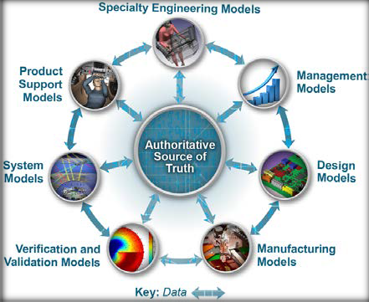

GOAL 1
Formalize the development, integration, and use of models to inform enterprise decision making
Key Implementation Updates
  Infusion in Policy & Guidance
  DoDI 5000.02, Enclosure 3, Section 9: Modeling and Simulation
  Model Based FMECA DID
  DoDI 5000.61, DoD M&S VV&A
  Other Efforts
  INCOSE Digital Engineering Information Exchange Working group (DEIXWG)
  USN Common Modeling Approach
Formalize the planning for models to support engineering activities and decision making across the lifecycle
Formally develop, integrate, and curate models
Use models to support engineering activities and decision making across the lifecycle
Notes:
Model development efforts are now considering use and reuse of their modeling efforts. This is driving modeling practice improving consistency with an aim towards achieving a fully realized digital twin of the final product.
List below are relevant efforts across the Department:
Released SEP 4.0. Includes planning guidance for modeling, simulation and digital engineering.
Released: Engineering of Defense Systems Guidebook
Released: Systems Engineering Guidebook
In Process of Development: DODI 5000.DE addressing the use of models to make informed decisions
Updating VV&A policy and model practice guidance to address DE i.e. credibility, curation, quality, consistency
FMECA DID and Model Profile
Other efforts include Services and Industry developing and maturing model development standards
INCOSE DEIXWG are establishing standard modeling methods
The INCOSE Digital Engineering Information Exchange Working Group (DEIXWG) grew out of the need to define a list of Digital Artifacts that could be used in place of the documentation that is asked for today. This need came out of the OUSD R&E ETE team. The team ran a workshop at the INCOSE International Workshop (IW) with the USAF in 2019 and realized it wasn't as simple as creating a list. As a result OUSD R&E ETE worked with INCOSE and NDIA to establish the DEIXWG to address this need. The DEIXWG has regular meetings and will soon be releasing products like the Digital View Model (DVM) and the DEIX Standards Framework. These products would be used to aid in specifying Digital Artifacts based on Use Cases.
The USN Common Modeling Approach:
This approach has grown out of the Navy's Digital Systems Engineering Transformation (D-SET ) efforts that have been going on since before the release of the DE Strategy. This approach was initiated by NAVAIR and has now propagated across all of the Navy Centers. The Common Modeling Approach includes a widely available Integrated Modeling Environment (IME) as well as the Naval Digital Engineering Body of Knowledge (N-DEBoK). These environments are accessible by anyone across the DoD. All you need to access the environment is a CAC and an account. This will allow you access to the modeling tools, model templates, model libraries, modeling policy, procedures, guidance, and model examples. In addition the Navy has established levels of training around this approach. The approach is growing to include specialty and other engineering domains. Although this Common Modeling Approach is mentioned for Goal 1 it spans across all of the goals. The D-SET has regular meetings that open to anyone that wants to attend.
Similarly, the Air Force has their Digital Campaign effort to implement Digital Engineering. The Army ASA/ALT and AFC have just recently started a Digital Engineering effort that will span across of there many centers which have all been doing great work. This, like the Navy effort will drive towards commonality and ultimately will drive more consistency and quality into engineering practice with the goal of better support to the warfighter.

Slide 8
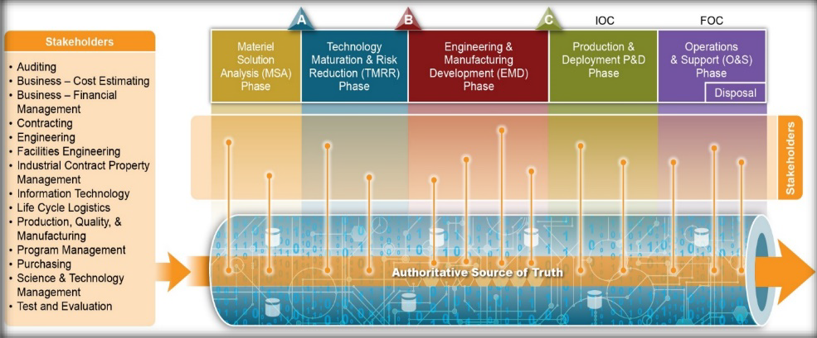
GOAL 2
Key Implementation Updates
Provide an enduring authoritative source of truth
  Infusion in Policy and Guidance (see previous slide)
  INCOSE Digital Engineering Information Exchange Working group (DEIXWG)
  OSD and Service Government Reference Architecture (GRA) and Mission Thread coordination and development
  Service Digital Models and Digital Twin Efforts
Plan and develop the authoritative source of truth
Govern the authoritative source of truth
Use the authoritative source of truth across the lifecycle
Notes:
In order to provide an enduring authoritative source of truth, there must exist solid data management practices that include data from across all engineering domains to include traceability and to realize the digital thread.
INCOSE DEIXWG: The primary goal is to support an enduring authoritative source of truth and establish a finite set of digital artifacts that acquiring organizations and their global supply chains should use to request an exchange with each other as well as internally between teams/organizational elements.
OSD and Service GRA and Mission Thread example: OSDR R&E Mission Engineering Process - Provides an analytical, data-driven approach to decompose mission elements; collect and analyze trustworthy data for the development of accurate models; develop realistic mission threads and mission engineering threads; and deliver recommendations and artifacts that help inform investment decisions. Key outputs include Government Reference Architectures and Mission Threads that can be flowed down to stakeholders of interest.
Examples of Service Digital Models and Digital Twins Providing an Enduring Authoritative Source of Truth:
The Army has pilot efforts and initiatives to create digital system models and digital twins at different phases of the lifecycle. A few examples are the Digital Twin for Small Caliber (DT2SC), Echelon for evaluating sensors, and the UH-60 Black Hawk Helicopter Digital Twin. DT2SC is enabling complete analysis and optimization of small caliber ammunition to expedite transition from low-rate initial production to full rate production. Echelon is looking earlier in the lifecycle to define a digital system model that’s not tied to a current radar system but rather can be used as a reference for requirements development, analysis, and evaluation of a future radar systems and technologies. The Army’s largest Digital Twin effort is focused on the UH-60 Black Hawk to improve readiness.
The US Army DEVCOM CCDC AC integrated Model Based Engineering environment (iMBE) effort established a prototype environment to integrate tools and data such that a Digital Thread can be established across engineering domains. This environment was designed so that a digital thread can be created for all programs the organization supports.
The US Navy CVN-78 Gerald Ford has developed what you might call a "limited" Digital Twin to be used to largely support manufacturing, assembly, and maintenance activities. The Navy is also making investments in technologies to best understand their application for Naval Digital Twins (NDT) that could be used to support Prognostic Health Management (PHM) and Hull, Mechanical and Electrical (HM&E) degradation, remaining useful life, impending casualty and/or stealth implications.
The Air Force is working with Wichita State to scan and generate 3D models and Finite Element Models (FEM) of the F-16 and B-1 and will use flight test data to validate the FEM's. The B-52 Commercial Engine Replacement Program (CERP)leveraged digital twins of the proposed engine designs in a “digital fly-off” to aid decision making early in the program. The Air Force is also pursuing efforts to develop digital twins of an entire installation to help make base improvement decisions.
Digital Twin Concept:
The Digital Twin concept is being matured by the services,. It isn't clear that there are any examples a full system realization of a Digital Twin. It is fair to say that most programs today have a geometric equivalent "Digital Twin" of the physical product. They also tend to have functional models and simulations used to estimate performance. That said there are many complex subsystems that will have full digital twins such as aircraft and ground vehicle engines. In some cases the engines are instrumented and can provide operational data that is used in the Digital Twin to predict performance, and maintenance activities. In fact, most satellites have on board diagnostics that are feed back to monitor health and to predict how best to maneuver them so that they maintain an optimal orbit. We know that there are some systems like the A-10, which is in sustainment, that is now starting to realize a digital twin. As changes are made to this legacy system the twin is establish for the parts of the system that are undergoing upgrades.

Slide 9
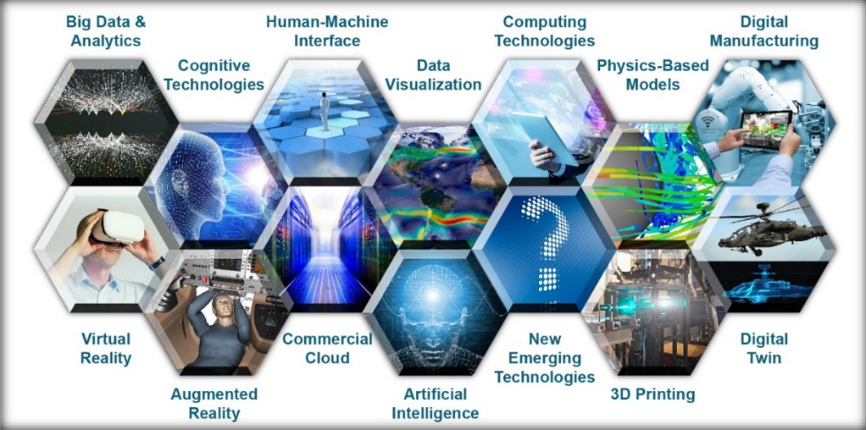
GOAL 3
Key Implementation Updates
Incorporate technological innovation to improve the engineering practice
  USAF Digital Campaign
  USN Digital Transformation
  Army Digital Transformation
  Cutting-Edge Digital Engineering Tools Across the Workforce (ex. PLM tools, ADVANA, CAMEO, Satellite Tool Kit (STK), ModelCenter
Establish an end-to-end digital engineering enterprise
Use technological innovations to improve the digital engineering practice
Notes:
We are focusing on leveraging high performance computing, cloud networks, open standards. Organizations have vibrant research efforts going on to explore opportunities to use Data Analytics, AI/ML, IOT, Improved Human Machine integration virtual reality, augmented reality.
Key Implementation Updates on Incorporating Technological Innovation:
USAF Digital Campaign. The Department of the Air Force Vision is, "A digitally-empowered Air Force equipped with an agile workforce, state-of-the-art technologies, and intuitive processes that drive model-based enterprise decision-making, enable automation, institutionalize open architectures, and leverage authoritative models and data to ensure seamless stakeholder collaboration across the acquisition lifecycle." The Campaign is a coordinated effort to move the activities of the enterprise, government and industry to modern digital capabilities and processes. The desired end state is a collaborative, integrated digital environment that guides, orchestrates, and delivers the means for each individual across the enterprise to access the data, functions and elements needed to do a his or her job in a purely digital manner. This includes all functions, from acquisition to sustainment and beyond, not just engineering.
USN Digital Transformation. This US Navy and Marine Corps Digital Systems Engineering Transformation Strategy is intended to transform systems engineering capabilities by using common, composable, interactive, model-based systems to store and exchange data, models, and information within and across programs. Digital Engineering uses models and authoritative data to coordinate and integrate all disciplines and phases of work for the life cycle of a platform or system. Digital Engineering allows engineers and leaders to better understand and assess complex choices, automates requirements traceability to achieve design satisfaction, and supports timely decision making through integration, automation, visualization, and high performance computing.
The Army Digital Transformation Strategy (ADTS) is the Army’s strategy to achieve digital transformation across Army technologies, processes and people. The strategy provides an overarching framework to achieve a digital Army of 2028 empowered to deliver overmatch through joint multi-domain operations (MDO). The ADTS will drive digital transformation, innovation, and reform through strategy, policy, governance, oversight and rapid capabilities to establish an operational MDO force. Elements of the strategy include: Software Factory: The Army trains the workforce to create software and prepare for highly technical battlespaces that are ambiguous, fast-paced and data/software-driven. Software Engineering Center: Addresses the challenge of software assurance (SwA) by publishing a new Department of the Army Pamphlet 25-2-5. The pamphlet provides clear guidance for improving security for future government off-the-shelf (GOTS) and commercial off-the-shelf (COTS) software fielded within the Army. Army Cloud Plan: Establishes both unclassified and classified cloud environments called cArmy to enhance and streamline access to data. cArmy enables faster data access, allowing the Army to operate in an agile landscape, monitor permissions and access, and deploy digital products quicker than ever before.
Cutting edge DE tools used by the government, contractor and academia workforce:
PLM: Product lifecycle management (PLM) is an information management system that integrates data, processes, business systems, and, people in an extended enterprise. PLM software allows to manage this information throughout the entire product lifecycle efficiently and cost-effectively: from ideation, design, and manufacture to service and disposal.
ADVANA: A modern data platform that pulls data from hundreds of business systems to make data discoverable, understandable, and usable for advanced analytics aligned to the National Defense Strategy. From finance and contracts to logistics and readiness, this system drives informed decision making across the organization through common data models, natural language discovery, and self-service analytics.
CAMEO - Cameo Systems Modeler ™ is an industry leading cross-platform collaborative Model-Based Systems Engineering (MBSE) environment, which provides smart, robust, and intuitive tools to define, track, and visualize all aspects of systems in the most standard-compliant SysML models and diagrams.
Satellite Tool Kit - Systems Tool Kit (STK) is an indispensable digital mission engineering application for the aerospace, defense, telecommunications, and other industries. It features an accurate, physics-based modeling environment to analyze platforms and payloads in a realistic mission context.
Model Center - Phoenix Integration’s ModelCenter is a vendor-neutral software platform that empowers engineers to create and automate multi-tool workflows, providing increased flexibility to solve challenging engineering problems, and ultimately delivering on the promise of MBE. ModelCenter MBSE bridges the gap between engineering analysis and the systems model, ensuring that the product requirement is met and in sync with the engineering analysis conducted throughout the product development process.

Slide 10
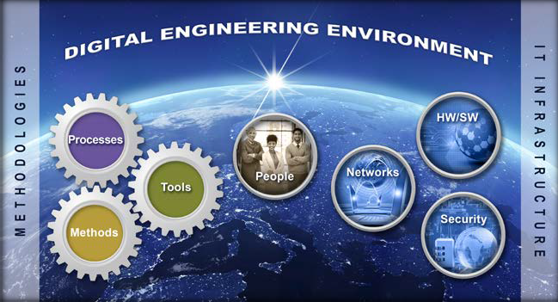
GOAL 4
Establish a supporting infrastructure and environments to perform activities, collaborate, and communicate across stakeholders
Key Implementation Updates
  USAF Digital Campaign
  USN Digital Transformation
  Army Digital Transformation and “Cloud Smart” approach
  Cloud Hosting Services and Platforms (ex. Cloud One, High Performance Computing Modernization Program (HPCMP), AF Digital Engineering Environment Sandbox, Navy Integrated Modeling Environment)
Topic
Develop, mature and use digital engineering IT infrastructures
Develop, mature, and use digital engineering methodologies
Secure IT infrastructure and protect intellectual property
Notes:
All services and industries have increased their enterprise infrastructure investments to include efforts around improving data protection and data access. The infrastructure is an important part of this. Also all the services are driving towards a cloud based network architecture approach.
Key Implementation Updates on Establishing a Supporting Infrastructure:
USAF Digital Campaign. USAF is working towards developing an Integrated Environment. They are providing overarching guidance to influence corporate IT improvement investments to enable a robust, secure infrastructure for the enterprise-wide Digital Campaign. Efforts include providing an Integrated Digital Environment (IDE) of models and tools for collaboration, analysis, and visualization across the functional domains of Air Force users
USN Digital Transformation. The Navy is developing a comprehensive, enterprise-wide capability that provides tools, infrastructure, and support for Naval Model-Based Systems Engineering (MBSE) efforts. Covers a wide range of areas from shared licenses and server-based repositories to knowledge and data management.
Army Digital Transformation and “Cloud Smart” approach: The Army will adopt a “cloud smart” approach that supports the migration of enduring applications in existing Army Enterprise Data Centers (AEDC) and Installation Processing Nodes (IPN) to Army’s cloud to achieve cost savings, interoperability, and information sharing across applications.
Cloud Hosting Services and platforms. Examples - Cloud One, High Performance Computing Modernization Program (HPCMP), AF Digital Engineering Environment Sandbox, Navy Integrated Modeling Environment)
Other Efforts Supporting Infrastructure Development:
Congress is now onboard with new laws being put in place, i.e. section 231 that makes it law to have an infrastructure and environment for SW development efforts that supports automated test and evaluation of SW solutions. The department has responded with a number of recommendations along with changes that are being incorporated across many policies and guidance that are being updated. As an example DOD 5000.DE is including such language. In addition the SEP template was recently updated and it has been heavily modified to consider planning for Digital Engineering activities to include the Development, Operation, and training needed for realizing a Digital Engineering Ecosystem. In fact, there are other efforts such as TRMC which provides for a modern day test support environment that can be used for joint test and evaluation efforts along with MEDE that was stood up to support Mission Engineering join mission analyses efforts. In fact, the global pandemic stressed the Infrastructure and Environment and forced many changes to accommodate a 100% remote workforce. Essential to achieving Digital Engineering is the establishment of and change to this part of our government enterprises.
In addition there are enterprise efforts to drive towards bodies of knowledge and to improve on how information is collected and shared across organizational boundaries.

Slide 11
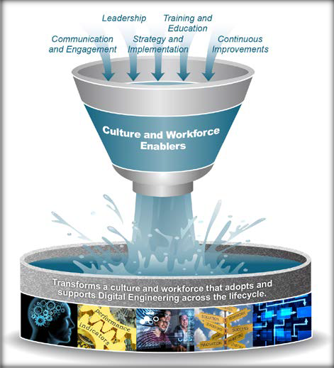

GOAL 5
Key Implementation Updates
Transform the culture and workforce to adopt and support digital engineering across the lifecycle
  Digital Engineering Body of Knowledge (DEBoK) Vision
  USAF Digital Guide
  USN MBSE Guidebook
  Service Workforce Training
Topic
Short Description
Improve the digital engineering knowledge base
Lead and support digital engineering transformation efforts
Build and prepare the workforce
Notes:
Leadership is stepping up, setting goals and advocating for change. They are working to change the culture, encourage sharing and are marketing and advertising new capabilities. It is in requests for proposals, as well as in the responses.
Training curriculum is changing due to demand and difficulty in finding the workforce talent needed to work efficiently and comfortably in a digitalized world.
Key Implementation Updates on Transforming the Culture and Workforce:
DEBOK - The Digital Engineering Body of Knowledge (DEBoK) serves as a reference for the DoD engineering community to use in implementing digital engineering practices; starting with systems engineering and expanding to specific disciplines, engineering domains and specialty areas. The BoK stores collective data, information and knowledge on digital engineering. Members of the government, industry and academia working within this space will be able to contribute to the DEBoK and build their digital engineering solutions based on collective knowledge.
USAF Digital Campaign Guide. An information strongbox for transformation efforts. The repository is a focal point for policy, training information, best practices, new, and resources relating to the digital transformation. “The Air Force Digital Guide is the authoritative source of information about products being worked for the Department of the Air Force Digital Campaign.
USN MBSE Guidebook. Similar to USAF Digital Guide. Provides guidance to USN on MBSE best practices
Other:
SERC research DE competency framework is influencing changes into DAU training to include greater emphasis on Digital Literacy.
DAU has a DE Credential which they will continuously improve.
Universities are offering Digital Engineering programs and are changing their curriculums to assure students work in a digitalized engineering environment.

Slide 12
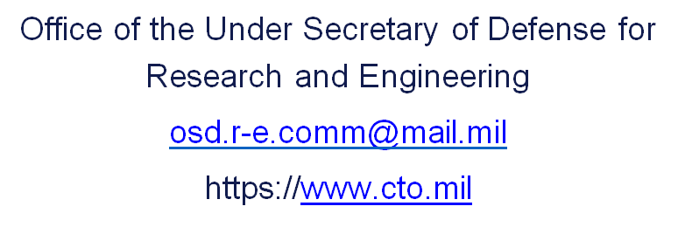
For Additional Information

Slide 13
BACK-UP SLIDES

Slide 14
DSB GEMS Task Force(2018) – Imagine if…..
Acquisition decisions were based on competing proposed models inside a synthetic multi-domain battlespace environment
  improving performance and saving money
Every fielded system had a “digital twin” that reflected the actual experiences of the system throughout its lifecycle
  enabling planned maintenance and situational upgrades
Joint training was conducted via distributed simulations and immersive environments representative of anticipated battlespaces
  and available wherever and whenever needed
An ongoing campaign of experimentation was established for every mission scenario to develop new concepts/CONOPs
  engaging warfighters and motivating innovation
From DoD Defense Science Board Task Force Briefing on Gaming, Exercising, Modeling and Simulation (GEMS) – chaired by Dr. LaPlante, and Dr. David:]

